Slide 1
National History Day
In Wisconsin 2020
Notes:
Welcome to your NHD adventure!! This presentation will get you familiar with National History Day and the process. Sit back while we go over the basics of the project.

Slide 2
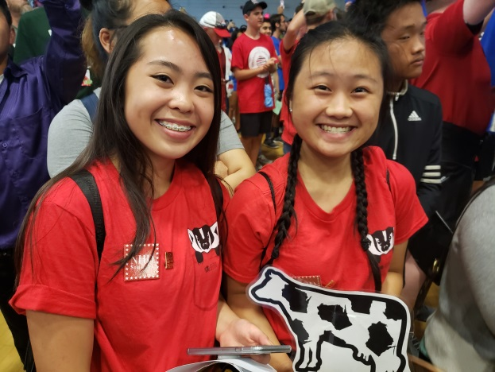
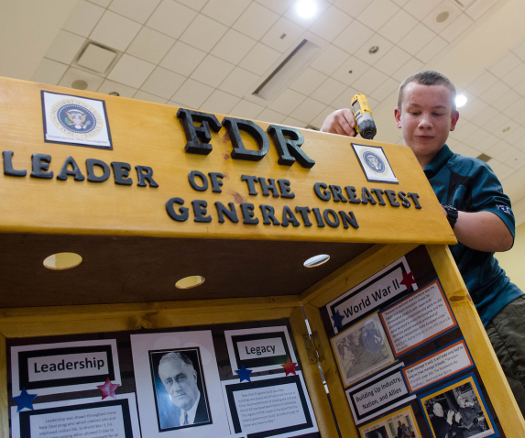
What is NHD?
Notes:
What is NHD? A question you are all probably pondering.
NHD is a project done in all 50 US states and in several countries around the world! Each NHD student studies whatever history they want, researches, and makes a creative project.
That’ll be you!

Slide 3
Theme
Past Themes:
2020 Theme:
All kinds of barriers!
Don’t forget “in History”
Notes:
Think of NHD as studying history with a twist because each year there is a theme all students must relate to. It’s a way of thinking about history from a new perspective. Most people think of history as memorizing dates, people and events, but with a theme NHD is trying to encourage more of you own analysis and think about facts with a new lens.
This year it is “Breaking Barriers in History.” This is a BRAND NEW theme and has never been used before, so get creative! There are all sorts of barriers whether you think physical (like climbing Mt. Everest) or figurative (like being the first Female President). Theme connection is VERY important in an NHD project, so pick wisely!
Oh- and the “in History” is a friendly reminder to place your topic in historical context. Don’t just talk about Rosa Parks and forget to mention the Civil Rights movement, ya know?

Slide 4
Define Breaking
Specific definition:
To separate into parts
To violate
To overcome, interrupt, or disrupt
Examples:
Going back on a promise/treaty
Trespassing
Records
Notes:
Let’s get into the theme, and really go back to basics.
Start with the first word: breaking. Who can give me a definition?
The specific definition is… (Listed) Now for some examples?
I thought of someone who broke a promise– whether a national oath or even among friends: it’s a break. There’s also a clear break of law whenever someone goes on someone else’s property, and then the good kind of break: break a record in triple jump or most runs in a baseball game. Break can mean a lot of things!
Ok, now onto the other word…

Slide 5
Define Barrier
Specific definition: something in the way
Examples:
Fencing
Language
Laws
Notes:
So now how would you describe a barrier?
The most basic way to explain a barrier is something in the way. Again, this can mean A LOT of things!
Are we talking physically (like a fence, that someone would trespass)? Are we talking about an invisible barrier like language (a German speaker trying to understand a French speaker)? Or both? A law is a visible document that tells you that you can or cannot do something. Of course, people can break that barrier (violate the law) easier than hopping a fence– but it’s STILL A BARRIER!
This can get tricky, but I’m here to tell you it is all about perspective… for example…

Slide 6
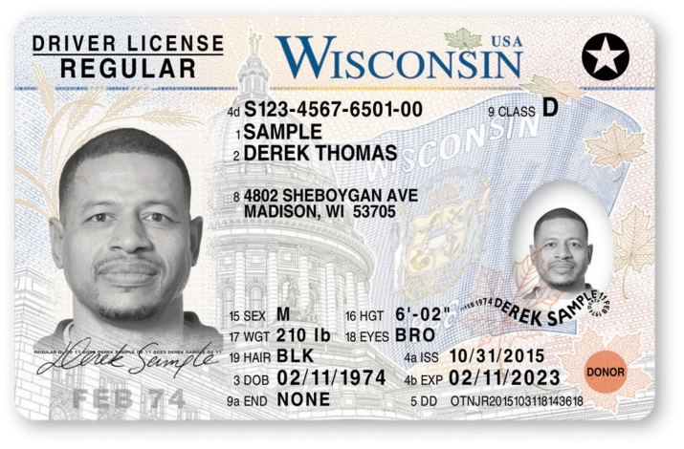
Barriers = Bad?
NO!
Safety
Qualify – Good Fit
Notes:
Are all barriers bad?
NO!
Some barriers are made to protect people. For example, this sign warns there is danger ahead. I’m glad this barrier exists! Another safety barrier are drivers tests. If you already have your license or wish to get one, there is a drivers test before you get your actual license to make sure you are ready for the road. Another good barrier to have!
If you decide to go to college, or when you apply for a job, you will have to fill out an application to see if you are a good fit for that role. It is a barrier to getting accepted, but a worthwhile process!
Let’s keep thinking about barriers…

Slide 7
Barriers
Notes:
Here are some common barriers:
There is…
Religion – some people cannot fully express themselves because their religion does not allow them to. Or sometimes cannot practice their religion because someone else does not allow them to.
Legal – or governmental barriers. Is there a law or authority figure that is preventing someone from doing something.
Money – overcoming something usually involves resources. Resources can be hard to find if you don’t have any money. In certain situations, money = power.
Ideas – people can have a conflict of ideas based on culture, status, or anything really! I bet you have heard people say, “think outside the box.” It can be hard to break out of routines and what has been done for years, decades, or generations.
Physical barriers – think about how land can separate people. What if all the chocolate in the world was on the other side of 1-mile wide river–I would try everything to get to the chocolate. Make a raft, swim, horseback, anything!
There are many types of barriers, and a variety of combinations. Some are harder than others. As you starting thinking about topics and barriers, there are a few things to consider…

Slide 8
Frequently Asked Questions
Barrier rebuilds or remains?
Thought a barrier broke
Another barrier rebuilds
Period of time
Cracks a barrier
Made progress, still working
It’s not over!
More than one barrier?
Only have one:
Focus on how and why
Keep researching, more may pop up
Have more than one:
Some barriers go together
Lean towards stronger research & sources
Lessons learned in history.
Notes:
Yes, you can talk about more than one barrier! Some overlap on their own—depends on your topic. There are a variety of barriers and combinations, and they will come out in your research.
Barriers do not have to be broken permanently. Sometimes another barrier occurs later on and it is not completely demolished. For example, Spearfishing Rights in Northern Wisconsin. In the 1800s, the Ojibwe signed treaties ceding or selling land, but keeping their rights to hunt, fish, and gather on their lands. Fast forward to the 1980s, non-native residents violently protested Ojibwe spearfishing on the lakes. Eventually the Voigt Decision confirmed Ojibwe had rights to spearfish as stated in the 1837 and 1842 treaties. The Ojibwe had to re-claim their rights, a barrier they did not expect to have.
Sometimes a barrier is not cleared entirely, but there is clear progress. For example: in medicine. There have been so many discoveries in an effort to find a cure or improve conditions for patients. We are still searching for a cure in cancer and many others.
Bottom line: MANY lessons have been learned or re-taught throughout history. So don’t forget to analyze that when you pick a topic: think about history!

Slide 9
Keep in mind
When selecting a topic:
Pick something YOU are INTERESTED in
Think about the theme
Think about HISTORY
What counts as history…
Notes:
If you take away anything, remember: pick something you like, always incorporate the theme, and place your topic within history!

Slide 10
History
The effects aren’t known right away
Allow time for:
Policy changes
Recovery
Economic shifts
International response
About 20 years
Notes:
When we say “history” we don’t necessarily mean the Roman Empire or 100 years ago, we mean allow time for the dust to settle.
Think about the last argument you had with someone– did you make up? Were you able to pause and read a bullet-point list of reasons you’re right and their wrong and what would happen if this or that happened? Probably NOT. Same goes for history. When events happen, no one really knows what’s going to happen. Sure, we have predictions, and they can be true, but consequences or benefits don’t usually show up right away.
Account for the time it takes for a bill to get approved, or a vaccine to be tested and proven for an illness, and other factors. Our best gauge is 20 years.
So after all of that, let’s look at a full topic-selection method…

Slide 11
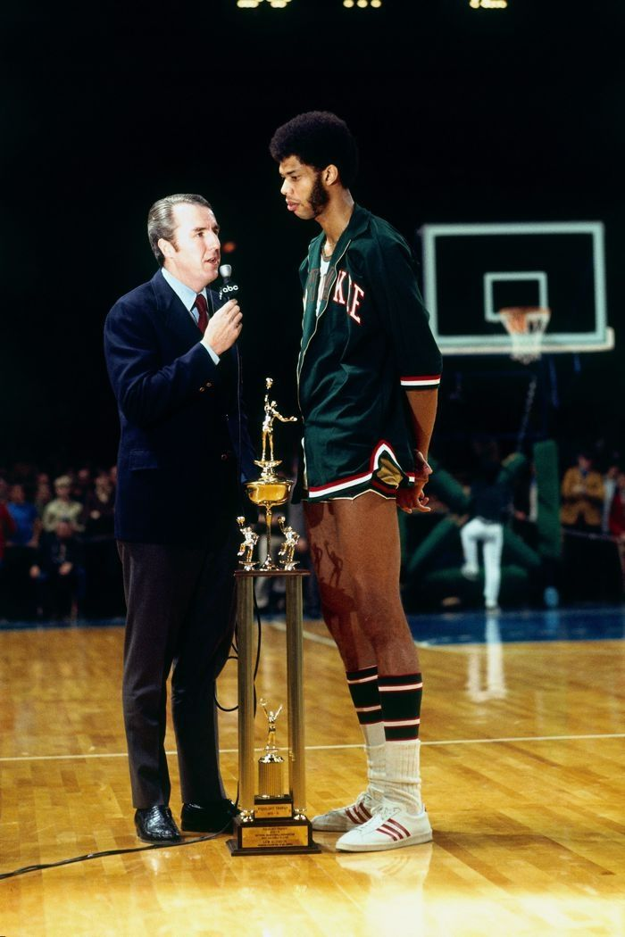
Narrowing a Topic
THEME
YOUR INTEREST
SPORTS
NBA
BROAD TOPIC
WISCONSIN SPORTS
NARROW TOPIC
BUCKS
KAREEM
ABDUL-JABBAR
THESIS/SPECIFIC ISSUE
Notes:
Here is a method you can use if you’re stuck. Start at the top with the most general: theme. You can’t change the theme.
Work your way down by think about a topic you’re interested in and then getting more and more specific. You don’t want to go super specific like down to an individual because that won’t be helpful. We call focusing on one person a “biohazard.” This means you are on track to write a biography about one person and not tell a broader story about what that person did or how that person influenced history.
Here is an example. If you’re interested in sports history, that’s great but we have to get to the bottom of what interests you. Well obviously Wisconsin sports teams are the best. The Bucks are an easy choice. But again, you can’t do a project just on the Bucks because it is too broad, you have to relate to the theme. I’m going to pick Kareen Abdul-Jabbar and show how to avoid a biohazard project.
Kareem is the NBA’s all-time leader in points scored and career wins, and in 2016 ESPN voted him the second best player in NBA history behind Michael Jordan. His stats are incredible, but his story goes beyond that. Kareem tells a bigger story of discrimination in sports. Many African American athletes participated in the 1960s-1970s Black Power Movement. A movement to protest racism as well as empower African Americans. At this time, Kareem was playing at UCLA. White players and coaches dominated the game and were threatened by Kareem and other black players. In an effort to limit black players’ abilities in the game, dunking was banned. Dunking became black athletes’ power or “act of defiance” (The Undefeated). Despite the backlash about ‘unfairness,’ Kareem continued to excel in his sport and stand by other athletes facing discrimination–like Muhammad Ali and Bill Russell. On and off the court black athletes fought for fair treatment and challenged the American status quo.
He continued blowing past barriers white Americans put around him and even boycotted the Olympics! His thinking was: how could I play for the USA when the USA does not believe in him? He echoed famous activists like Malcolm X who declared, “Being born here in America doesn’t make you an American.”
After college he started in Milwaukee and then went to the LA Lakers. Milwaukee was not easier for him nor for other players of color. Throughout his career, the racial barrier has followed him. He continued and continues to fight for equality being black and Muslim, so he encounters another barrier of religion. But one barrier he fully cleared is being a NBA player. Wow, what a huge achievement for anyone, much less be one of the best players ever. He focused on his game and lead both teams to victory while also gaining respect from the community.
If one person inspires you, that’s great! However, no one did anything alone. Kareem aligned himself with nationwide movements and there are many other people that make up his story.
Notice I did not mention where he was born, his mother’s name or how many brothers he had. Try to stay away from a narrative—sharing those facts or biographical bits of information—and analyze his experiences in history!
After you select your topic you’ll start figuring out what you want to research. You’ll start to learn more about the story…

Slide 12
How to Tell the Story
Starting point?
When do barriers break?
How does this happen? Who or what are driving the story?
Ending point?
Notes:
Who are the main characters? Where are they starting off?
They could be at the bottom facing a barrier while there is someone (or thing) enforcing barrier. Be sure to inform the viewer where you are starting in the story and how this relates to the theme– breaking barriers.
Same with the end– is it a happy ending or sad? And for who? Tell us! It may seem clear for you, but strong history projects are more than facts. Strong history projects tell the reader what happened while connecting to the theme. Keep the theme in mind throughout your whole project-making process!

Slide 13
Four B’s
Background
Barriers
Breaking
Begin Again?
Notes:
We’ll go over each of these steps in the next slides, but here is an overview.
Notice the theme words are switched around– that is because you have to identify a barrier before you can break it!
Let’s get into this!

Slide 14
Background
Context
What was happening?
Locally
Large scale
Broad Topic: Music history
What would be helpful to know?
Who? When? Where?
Narrow Topic: Dimitriy Shostakovich (Russian composer and pianist) [Link: previous WI National Finalist documentary]
Notes:
How to do this is to start with context. Bring your reader up to speed.
Think about leading up to the event, what happened in that place and/or globally. Any major factors a reader should know about? Don’t assume a reader knows everything.
For example: say you want to do a project on music– cool! There are all kinds of music and a lonnnngggg history of it, too!
Let’s use Dimitriy as an example. It is helpful to know he was composing music in what is now called Russia, but was the Soviet Union during his time. Like any artist, Shostakovich expressed himself through his art. However, the Communist government in the Soviet Union banned anything that did not show the USSR in a positive light. USSR Leader Joseph Stalin demanded musicians only write music approved by him or face harsh consequences.
It was not only artists that were being censored, but everyone. This regime monitored everyone and punished anyone who did not follow their rules.
Dimitriy had Stalin and the Communist regime as a barrier. He still composed music, but made it unorthodox and mismatched in order to symbolize how he felt. Working within the boundaries, Shoshtakovich still made music he was proud of. He broke Stalin’s barriers by creating a unique sound. His music was noted for its beauty and message and is still played today.
Tell your audience what genre, era, and place you are studying. Understanding where Shoshtakovich came from helps the reader understand his music and message. Narrow in on what interests you about music and start there. Don’t worry about getting everything right at first, start large-scale and step closer to your focus throughout your research.
Depending on what you plan to argue or study, the context you provide may vary. Think about your reader! What should they know?

Slide 15
Barriers
Describe what is in the way
For who? For all?
Visible or invisible?
What will it take?
What is in the way?
Broad Topic: Music history
Can men and women play the same instrument/song?
Narrow Topic: Crying Woman Singers (American Indian Women)
Notes:
What are the barriers are there in music? Many, right?
Like we talked about earlier, barriers look different for different people. This will may or not be obvious for people, so TELL YOUR READER!
For example: Can men and women play the same instrument? Same song? Play together?
Most do not even give it a second thought– of course women and men can play music together! That is not always the case. There are many examples of cultures (even to this day) where music is gendered. Meaning, only men can use certain instruments versus women. For instance, the Crying Woman Singers. This group of women began singing songs traditionally sung by men because they saw this art dying off. Rather than sit and watch this branch of their culture fall off, they save it by breaking tradition and singing.
The Crying Woman Singers are facing gender, cultural, and maybe even instrumental barriers (having never played a specific instrument before or knowing how to read music). Lots to explore here. One more note: this is not the only group of people to do this! Research! Research!

Slide 16
Breaking
What happened?
Describe what broke
Did it need to break?
Is this agreed?
Is this good/bad? For who?
Broad Topic: Music history
Who is the audience? Who are the creators?
Where is the music played?
Narrow Topic: WWI Jazz regiments (African American and Puerto Rican jazz musicians)
Notes:
With whichever or whatever barrier(s) you decide, ask yourself if it needed to break. Do all people see this barrier fall and cheer?
Think about the example of WWI Jazz regiments. During WWI, African American (as well as other ethnic minorities) traveled abroad to the war zones and performed. This was the 1920s, before the Civil Rights Movement, Black Power Movement, and nationwide protests began. Everything was still segregated– even the military.
So can you imagine the US going abroad and this regiment filled with non-whites performing for a mixed (white and non white) crowd? And people cheered and supported this group? Back home, that would never happen! However, overseas they were a hit!
Even white soldiers and Generals traveled to see this Jazz troupe perform. This regiment was not seen as a black band, but as talented musicians sharing their soul with the world. It was something to celebrate in a time of war. Their sound brought all people together.
In that instance, this group broke a barrier… well you could say cracked a barrier. When they returned home, this regiment was not treated like celebrities or even veterans. They were still discriminated against due to the color of their skin.
This is an unique example of how a racial barrier can break/crack. And also, this may have been the first time Europeans heard Jazz live! More barriers broken… something more to explore for sure.

Slide 17
Begin Again?
What changed?
Has anything changed?
Good?
Bad?
What can be improved?
Present day?
Broad Topic: Music history
Is this the end of change? Did it solve anything?
What mark did this leave on history?
Narrow Topic: Live Aid (1985 worldwide charity event)
Notes:
What has been changed since the barrier? Is it gone? If so, is it gone for good? Explain how this influenced history!
Live Aid–In 1985, all the top artists in the biz played in London and Philadelphia to raise money for victims of horrific famine in Africa. In 16 hours, the concert raised $80 million. This may not sound shocking to you know, but it was a HUGE DEAL then. Never before had musicians come together so successfully. Millions watched around the world and donated. It was all types of music, just a gathering of greatness never before seen.
We broke down a wall that we didn’t even know what there! Ever since this historic musical charity event, there have been many more. It took one successful event to see what the entertainment industry is capable of. Since, there has been more benefit events for all kinds of charities, most notably for AIDS and natural disasters. This broke barriers not only in the music industry, but for all kinds of marketing and fundraising.
Think about Red Nose day at Walgreens. That is a nationwide event that brings in millions of dollars each year.
See all the directions you can go with music?? Research and explore your interests.. You’ll never know what you can find.
But how to find out what has changed? How do you even find all this information? How did I know all this information? Do you want me to show my work?... Well that’s research!

Slide 18
How to Research
VISIT PLACES
Search online to start
Find a good book
Go to the back for the bibliographies
ASK QUESTIONS
Of yourself
With others
KEEP TRACK
Record search terms
Write down titles and authors
Note how the source helps you
Notes:
How are you going to find all these sources?
First, start with a simple Google search to familiarize yourself with your topic– is it the one? If you are liking a particular topic, find a book about the general history. Librarians are great people to ask for help finding a book or information. Once you find a good book or reliable website, look at the bibliography– you can find more sources from there!
Also, don’t forget to keep asking questions! Whether it’s “why did this happen?” or “how do I find that?” keep digging for information or ask someone. Like I said, librarians have so much information and know the research process– let them help you! You are not an island, use people/libraries/books/websites as lifelines to help you.
Lastly, keep track of what you do. Think about it like leaving a trail of breadcrumbs for someone else to find (or you can go back to!) In the end you’ll have to put together your own bibliography, so it’s best to start right away.

Slide 19
Research
This will be how you show your work!
Primary Sources
Secondary Sources
Notes:
In science or math you have to show how you got 4 as your answer. In history you have to do research to show that Thomas Jefferson was vegan (he wasn’t, and we know that because of research!)
Historians divide research into two big pots. In one there is primary sources– anything created (or alive) at the time of the event! A journal written by someone, the newspaper, music, pictures, or something like that.
The second pot is secondary sources– anything not created from the time of the event. Usually a book written about the event by someone that was not there, a documentary or a website written by someone that was not alive at the time. Think of secondary sources like “second-hand” clothes. You were there to pick them out, but you still wear them and are affected by that purchase.

Slide 20
Research is everywhere!
Notes:
Research is really everywhere. You have probably researched and not even known it. And it’s not like a detective in crime shows tracking down evidence and solving murders– it’s not that dramatic. Research can be seemingly little things. For example:
How else are you going to pick your defensive line in Fantasy Football, or are you okay with just anyone… I think not.
Also, doctors are doing research every time they take your blood or check your temperature. They are trying to gain more evidence to find the answer of what is wrong.

Slide 21
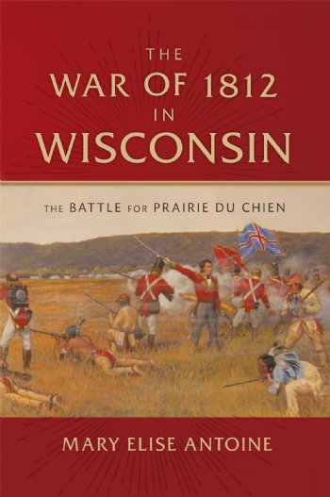
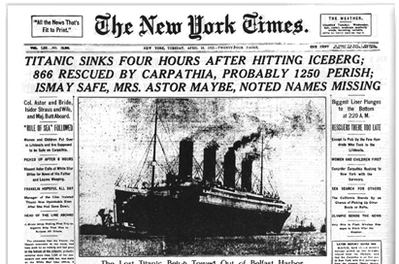
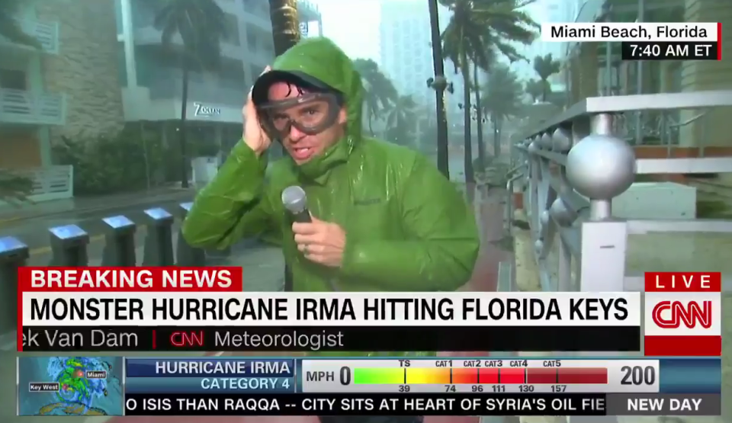
Research
CHECK THE DATE!
Primary or Secondary Source?
Secondary
Primary
Secondary
Primary
Notes:
Let’s go over some examples. Are these primary or secondary sources?
1/Weather broadcast. PRIMARY because it is live. It doesn’t matter that we are in Wisconsin and this is happening in Florida. This is live and thus a primary source.
2/1812 War book. SECONDARY because it is about a war that happened 200 years ago and was published in 2016 by someone who was not there.
3/NYT Titanic sinking. PRIMARY because this was created at the time of the event. It doesn’t matter that no one on the boat wrote it or it was not a European paper, it is a product of the time.
4/Titanic the movie. SECONDARY because it was not created at the time of the event. It is a recreation of the event with “what they think happened” combined with research and Hollywood drama. Not the best thing to cite.

Slide 22
Project types
Play to your strengths
Artistic ability?
Video editing?
Writing vs Acting?
How do you best work?
Sails vs. Anchors
Are you going to be friends in a few months?
Notes:
Alright, so how will this all come together?
You get to choose in which format you want to display your project, but first there are some things to consider:
First, think about your strengths! Are you artistic in the sense that you like glue sticks and color patterns? Or do you like video editing? That will help you decide whether or not to do a documentary versus an exhibit board or one of the other categories.
Also, do you want to work by yourself or in a group? A teacher once said to think about yourself as a ship– it’s a good idea to bring extra sails. Sails are great for you because they work hard to move you forward and makes your ship faster, more efficient and more enjoyable. However a poor decision is carrying anchors. Anchors don’t help you move forward and they weight you down. They do minimal effort. Just think about that before picking your group… and remember: if you sail alone, the boat sails easily.

Slide 23
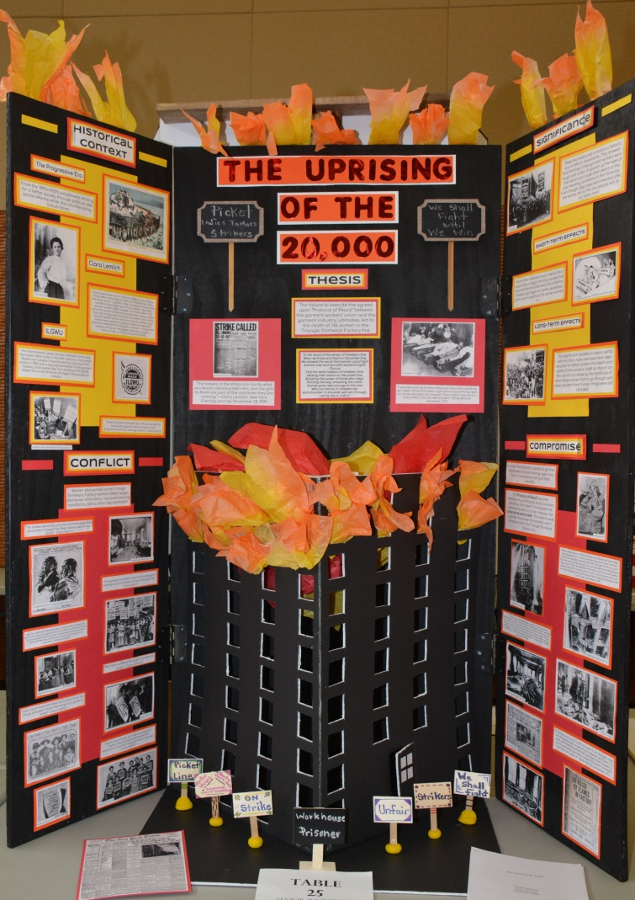
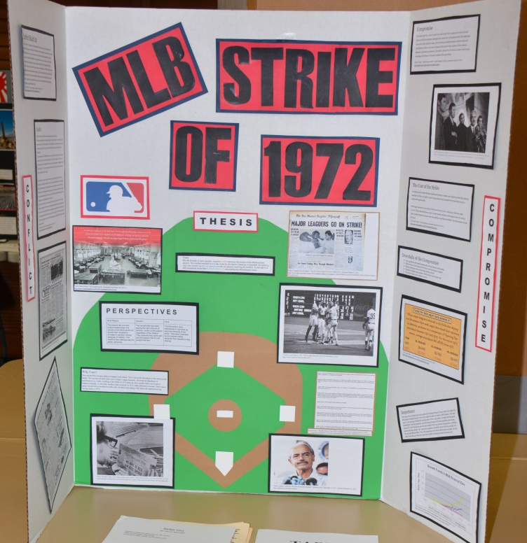
Exhibit
DO YOU LIKE CRAFTS AND ARE ARTISTIC?
500 words
Images or graphics
Can use media
Notes:
First is exhibit. This category is for students who like working with creative design which means you enjoy gluing images on a board and making your exhibit appealing. Think of when you visit a museum and see the exhibit halls, you want people to feel comfortable approaching your board to read and learn.
This is a good category if you have a lot of pictures. Ancient Greek topics don’t have a variety of images, so think about that when picking your topic. This is a tough category because you only have 500 words to work with. Of course you can add quotes, but the point is that you only have 500 words to teach your reader everything you want them to know about your topic. That’s not a lot.
Something to keep in mind if you want to compete, this is the most popular category! We have large exhibit halls.

Slide 24
Documentary
DO YOU LIKE EDITING WITH VIDEO?
DO YOU HAVE THE SOFTWARE?
10 minutes
Images AND video footage
Make your argument early
Notes:
Documentaries are fun if you like to edit video, but some people find it to be too much work compiling pictures and footage or they just don’t like the sound of their voice (but you won’t be judged by the sound of your voice!)
Before selecting documentary, check to see if you have the right software to do a documentary. iMovie is popular but there are other great types for a small fee or some Library Media Centers have equipment and software you can use. Ask around or ask the NHD in WI office!
For documentaries, you get 10 minutes to say what you want to say and it is also a very visual category. Again, a documentary is not the best category if your topic does not have any video footage. Really think about how you want to engage your audience.
One note I will say about that is to mention your thesis or your argument early and refer back to it throughout! Although you will know every piece, your audience is seeing it for the first time so be sure to help them out. Think of when someone is telling a story and talking really fast it’s hard to catch up. There are great examples online to look up from across the country. People make it their own and add their own creative style.

Slide 25
Paper
DO YOU ENJOY WRITING?
1,500 – 2,500 words
Individual only
Straightforward structure and organization to make your argument
Notes:
Don’t roll by this topic choice, it is a great option! Whether or not you enjoy writing, a paper allows you to speak to your reader in a unique way. The organization is simple, you don’t have to pick out colors or have lots of images– it’s just you and your reader; what do you want them to know?
You get a lot of space to write out your ideas (1,500-2,500) and it is much easier to give feedback on papers because it is simple– all your work is right there. It is not spread across multiple pages or you have to rewind.
Papers can only be done individual because it is hard to write a paper in a group! Many examples are online, check them out!

Slide 26
Website
DO YOU LIKE DOING ALL YOUR WORK ONLINE?
1,200 words
Can use media
Notes:
For a website, you have to work entirely online. Building the navigation buttons, drawing and dragging in text boxes– is that something you enjoy?
You can still be creative like an exhibit with formatting, but you get more words like a paper! NHD students who do a website have to use the special NHD platform
Check online for some examples!

Slide 27
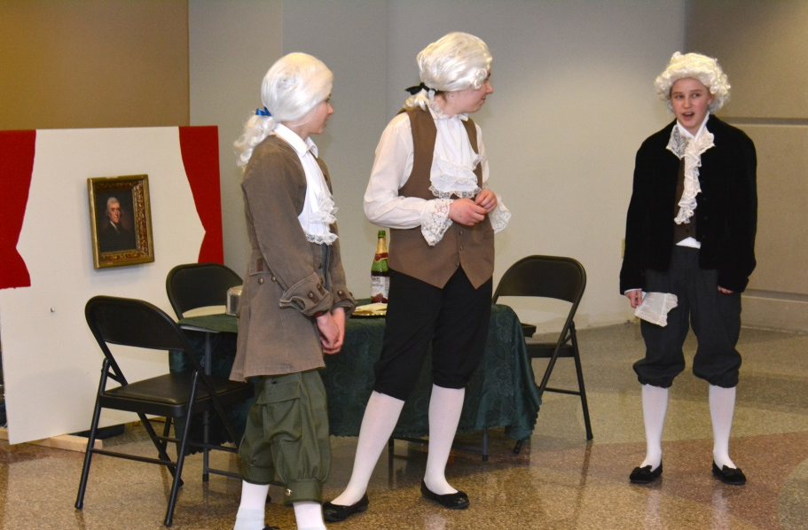
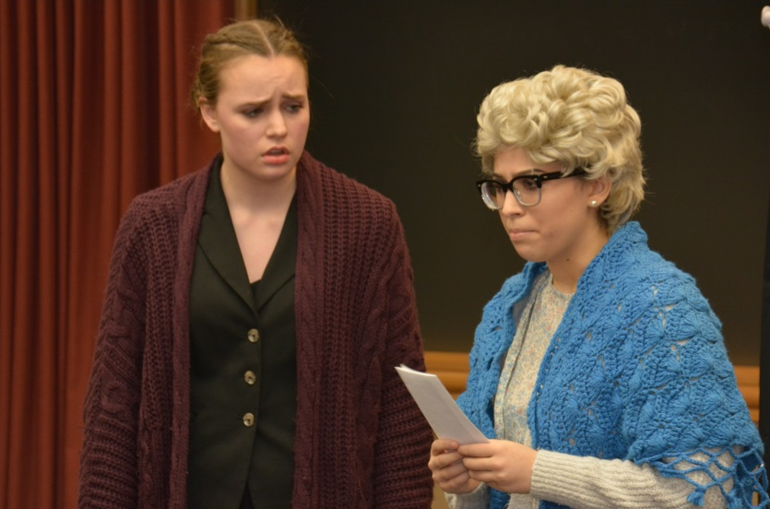
Performance
DO YOU LIKE PUBLIC SPEAKING?
ARE YOU IN IT TO WIN IT?
10 minutes
Props not necessary
Make an argument
Notes:
If you want to do a performance, ask if you like speaking in front of people or want to get better! Another thing to ask yourself is if you really really want to win… performances historically have the lowest participation rates. Some contests there was 1 or 0 entries. Just something to think about!
In general, you have to craft a historical argument in 10 minutes. Props are not required, but they can be helpful. They costumes can be as simple as the gals on the left or extreme as on the right– both were National Finalists! The key is that you can’t get swept up in the theatrical aspect, you still have to make an argument. That usually looks like, “Hi! I’m President Nixon and I’m here to tell you to vote!” Just get right to it!
Watch the examples online!

Slide 28
Annotated Bibliography + Process Paper
Annotated Bibliography
Annotated = You write a few sentences about how each source helped you learn about your topic.
Bibliography = Cite your source so someone can find it and give proper credit to the creator.
Process Paper
Needed if you want to compete (one per group)
Only maximum 500 words
Answer a few questions:
How did you pick your topic?
What did you find surprising?
Where did you find your favorite source?
Notes:
Remember that research I mentioned? You have to show your work in the form of an annotated bibliography.
Annotated means you write a little about each source. Bibliography means you give credit to the source that helped you and make the citation clear so someone could find the same information you did!
A Process Paper is needed if you decide to compete. A simple 500 words about your project. Just something to think about– and FYI, papers don’t have to write one!
More about competition…

Slide 29
Competitions*
*Optional
School Events
Regional Contests
State Competition
Madison, WI
National Contest
Washington D.C.
READ
THE CONTEST RULE BOOK!
Notes:
You can enter your projects into competition! You don’t have to have a school contest, but some do.
The starting point are regional contests– we have 7 across the state and you can check yours online. The top 3 in each category advance to the state competition at UW Madison. The top 2 at state advance to the National competition in Washington DC at the University of Maryland.
We really want to stress that it is OPTIONAL!! Doing an NHD project is an achievement in itself. If you do plan to compete, there is a contest rule book online you should read because it contains specific rules for each category. But seriously, you are already a stronger researcher, writer and creator by completing a project. Competition and “winning” is gravy.

Slide 30
Questions?
Historians ask a lot of questions.
Email National History Day in Wisconsin:
historyday@wisconsinhistory.org
We will respond ASAP!
Look at FAQs online:
wisconsinhistory.org/nhd
Lots of project help!
Notes:
Ask people questions! Ask what their favorite history is or if they know about the history you are interested in. You can find leads to sources, topic ideas, or connections for interviews!
Also, ask the NHD in WI office questions! They are open to all questions big and small.

